Slide 1
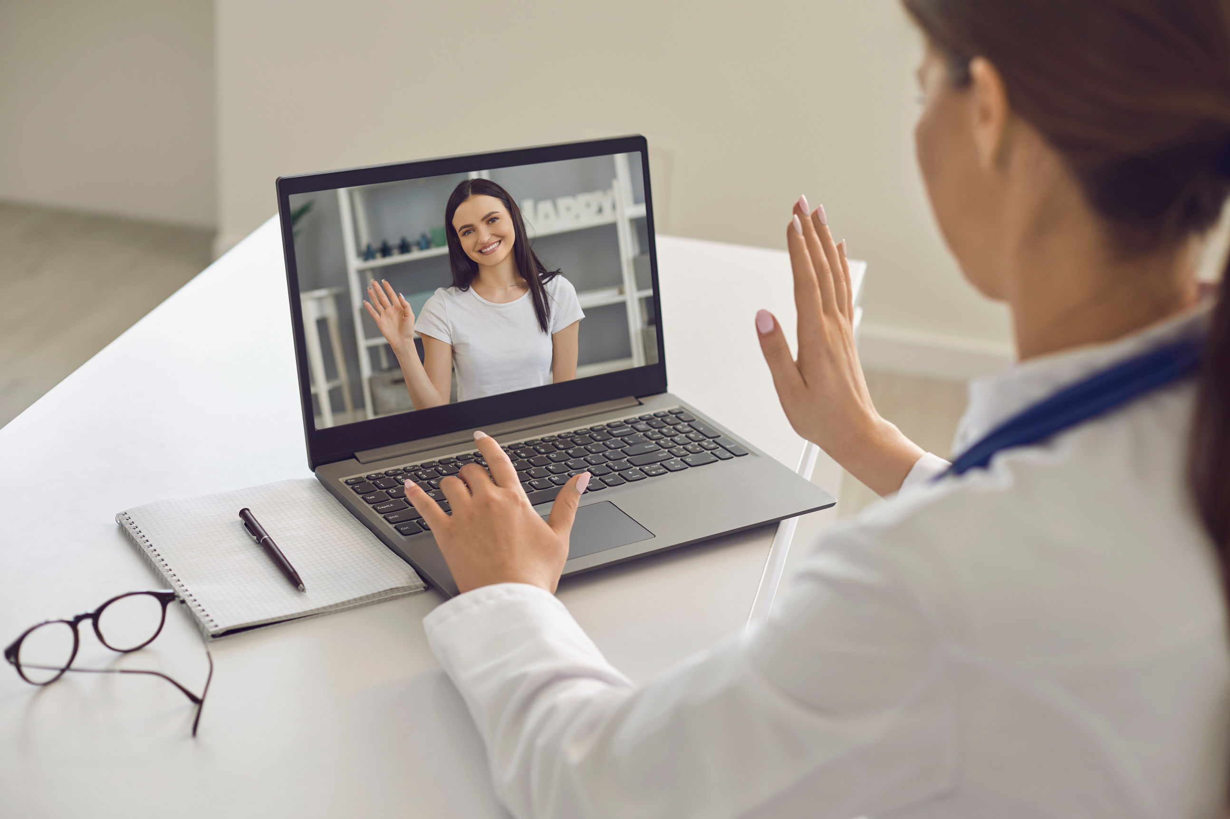
Telemedicine
:- A Modern Day Medicine Solution

Slide 2
Meet the Team
Vinamra Rawat
Shefali Jain
Swati Beniwal
21BAI10181
21BCE11433
21BCY10210
Dhruv Sharma
Shrey Patel
Mihirkumar Chaudhary
21BCY10014
21BCE10023
21BCE10616
Meghavi Jadav
Aditya Pandey
Harshitaa Ashish
21BCE11156
21BSA10141
21BCY10123

Slide 3


This project seek to improve patient outcomes through early diagnosis and timely interventions, while simultaneously reducing healthcare costs and minimizing the need for in-person visits. Telemedicine projects also strive to enhance the continuity of care, support preventive health measures, and empower patients to take an active role in managing their well-being.
Objective

Slide 4
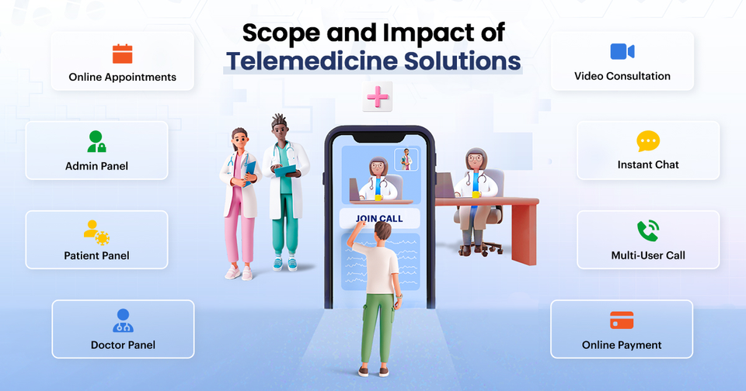
Health Education
SCOPE
Telemedicine platforms can disseminate health information and education to a broad audience.
Emergency Consultations
In emergency situations, telemedicine provides immediate medical advice, potentially saving lives.
Rural Healthcare
Telemedicine extends healthcare facilities to rural areas where medical infrastructure is limited.
Reducing Healthcare Costs
Telemedicine reduces the financial burden on patients by eliminating travel expenses and reducing the overall cost of healthcare services.

Slide 5
Government Initiatives
Geographical Accessibility
he Indian government has been promoting the use of IT in healthcare through initiatives like the National Health Portal and the National Digital Health Mission. Such initiatives can lead to increased job opportunities in healthcare IT.
Telemedicine eliminates the need for patients in remote or rural areas to travel long distances to access healthcare services.
Language Access
Pharmaceutical Consultations
It breaks language barriers, enabling healthcare consultations in multiple languages to improve accessibility for diverse populations.
Telemedicine can extend to pharmaceutical consultations, allowing patients to discuss medication options, side effects, and interactions with pharmacists through video calls.
Additionally, The COVID-19 pandemic may have influenced the healthcare industry, potentially accelerating the adoption of digital solutions.

Slide 6
Introduction
Methodology
Telisio is a telemedicine platform. In today's healthcare landscape, access to quality medical care is more vital than ever, and Telisio is at the forefront of making healthcare services accessible from anywhere. Telemedicine, as seen through Telisio, is the future of modern healthcare.
The Telesio Way
Objective
Our primary objective today is to outline the methodology behind Telisio's development and implementation. We'll be sharing the key steps that will be driving Telisio to transform the healthcare industry. These steps are vital in realizing our mission to make quality healthcare services readily available to all, regardless of geographical constraints

Slide 7
02
01
Technology Stack
Research & Analysis
Present the choice of technology and platforms for Telisio's development, emphasizing scalability and security.
Describes how we conducted market research and analyzed user needs to tailor our telemedicine solution.
03
Development Process
Explain the agile development approach and how we iteratively build and test Telisio's features.
04
05
User-Centric Design
Security & Compliance
Highlight the importance of user experience and user interface design for seamless patient-doctor interactions.
Discuss the security measures and regulatory compliance to ensure patient data safety.

Slide 8
06
07
Testing & Quality Assurance
Deployment & Scaling
Describe the deployment process and how we plan to scale Telisio to accommodate growing demand.
Explain the rigorous testing procedures and quality control to ensure a robust and reliable telemedicine platform.
08
09
User Training
Support & Maintenance
Mention how we provide training for doctors and patients to use Telisio effectively.
Highlight our post-launch support and maintenance plan to ensure smooth operations.

Slide 9
Improved Healthcare Access:
Increased accessibility to healthcare services, especially for individuals in remote or underserved areas, resulting in timely medical consultations and treatment.
Expected Outcomes
Public Health Benefits:
During pandemics and health crises, telemedicine reduces the spread of contagious diseases by minimizing in-person visits and promoting remote healthcare.

Slide 10
Efficient Healthcare Delivery:
Streamlined healthcare services with reduced waiting times, improved scheduling, and efficient allocation of resources.
Expected Outcomes
Mental Health Support:
Increased accessibility to mental health services, promoting emotional well-being and early intervention for mental health issues.
Cost Savings:
Reduced travel and transportation costs for patients, as well as potential savings in healthcare expenses, making medical care more affordable.

Slide 11
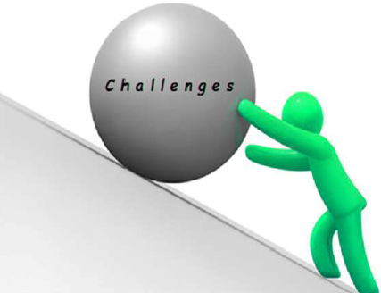
INTIAL
CHALLANGES

Slide 12
01
04
Insufficient medical
and technological infrastructure
Lack of
Standardization
02
05
Urban-rural digital divide
Patient Acceptance
03
06
Emergency Situations and Hands-On Procedures
Lack of physical examinations

Slide 13
Despite these initial challenges, telemedicine has made significant strides, especially with the onset of the COVID-19 pandemic, which accelerated its adoption and addressed some of these issues. Regulatory and reimbursement policies have been adjusted, and both providers and patients have become more accustomed to virtual care. While challenges remain, telemedicine continues to play an increasingly important role in healthcare delivery.

Slide 14
Description of telemedicine web-app

Slide 15
A telemedicine web app is a digital platform designed to facilitate remote medical consultations and healthcare services through the internet.
It enables patients to connect with healthcare professionals, such as doctors or specialists, using a combination of video calls, voice calls, and text chat.
Users can schedule appointments, securely share medical records and images, receive diagnoses, and obtain prescriptions or treatment recommendations without the need for physical in-person visits.
Telemedicine web apps prioritize user privacy and data security and may include features like appointment scheduling, electronic health record integration, file sharing, and payment processing.
These platforms aim to make healthcare services more accessible, convenient, and flexible, especially for patients who may have difficulty accessing traditional in-person care.

Slide 16
Significance
Telemedicine has a number of significant benefits, including:
Increased access to healthcare : Telemedicine can help people in rural or underserved areas, or with difficulty traveling, to get the healthcare they need.
Reduced costs: Telemedicine can save patients and providers money on travel and other expenses.
Improved convenience: Patients can receive care from the comfort of their own homes at a time that is convenient for them.
Improved quality of care: Telemedicine can connect patients with specialists who may not be available locally and improve coordination of care between providers.

Slide 17
Potential Impact
Reduce disparities in healthcare: Telemedicine could help to reduce disparities in healthcare by providing access to high-quality healthcare to people in all communities, regardless of their location or socioeconomic status.
Improve public health: Telemedicine could help to improve public health by making it easier for people to get preventive care and screenings. It could also help to track the spread of disease and identify outbreaks more quickly.
Empower patients: Telemedicine could empower patients by giving them more control over their healthcare. For example, patients could use telemedicine to track their own health data, get second opinions from specialists, and make informed decisions about their care.

Slide 18
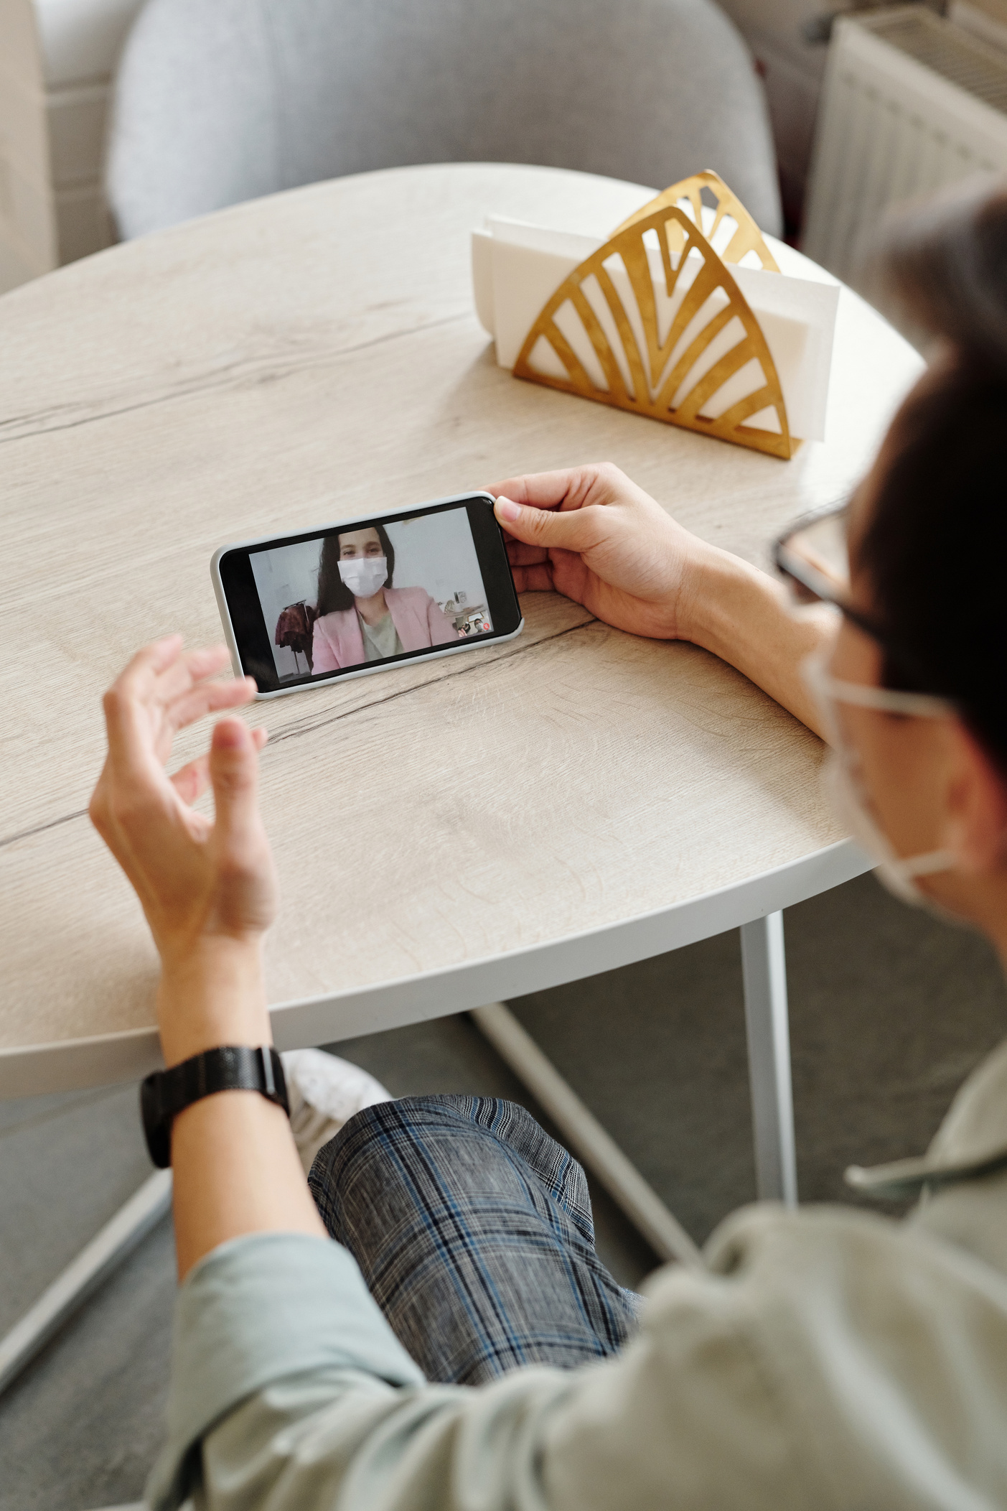

Target Audience
The target audience for telemedicine in India is diverse
Reflecting the country's vast population and healthcare needs. Telemedicine can be a valuable tool to address various healthcare challenges in India

Slide 19
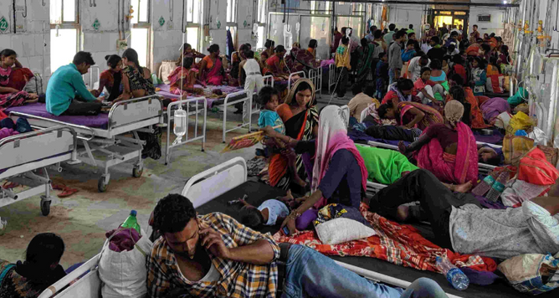
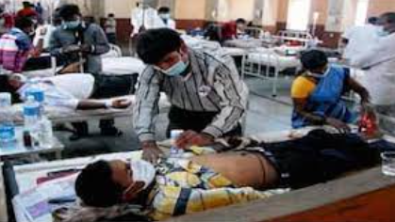
Primary Target Audiences
1) Rural Community
Lack easy access to healthcare facilities
Telemedicine can connect residents in remote regions
with healthcare providers
2) Urban Dwellers
Long wait times at clinics and hospitals.
Time-effective means

Slide 20
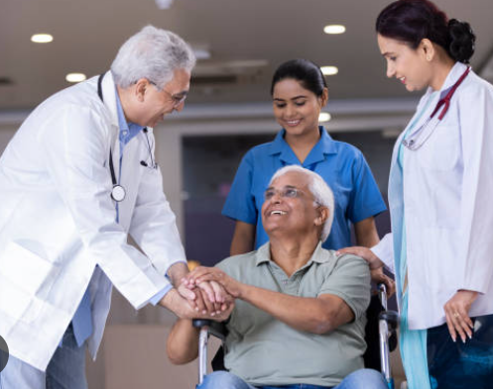
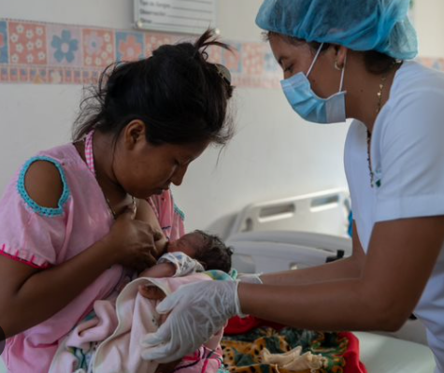
3) Elderly Population
Elderly individuals may have limited mobility
Help seniors access medical consultations and check-ups
4) Maternal and Child Health
Providing access to obstetricians and pediatricians

Slide 21

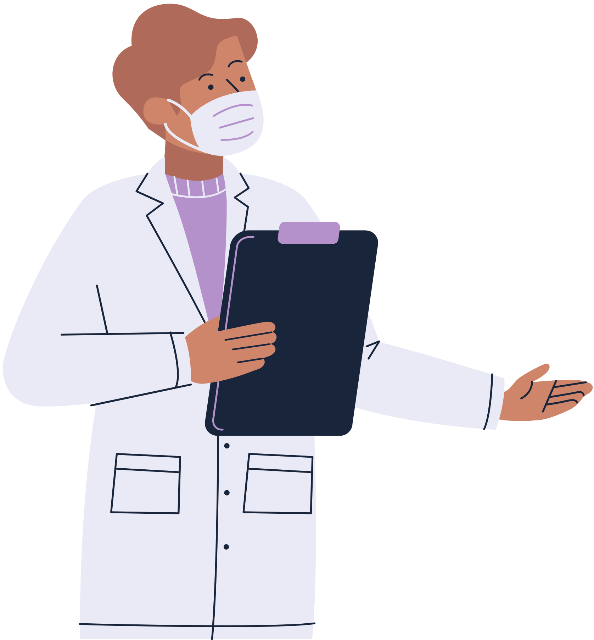
Beside all these there are situaltion like
Patients with Chronic Conditions
Follow-up Care
Mental Health Services
Corporate and Occupational Health
Health Camps and Outreach Programs
Pharmacies and Retail Clinics

Slide 22

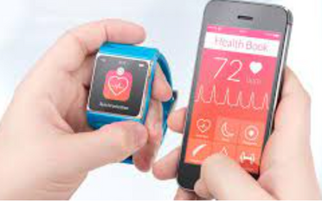
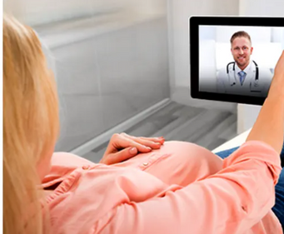
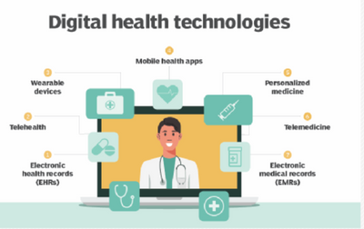
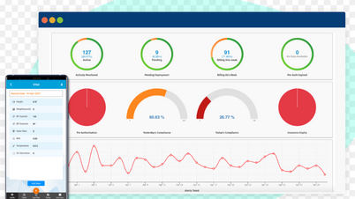
Different From Existing Systems
Accessibility: Telemedicine provides remote access; traditional healthcare often requires in-person visits.
Convenience: Telemedicine offers on-demand and scheduled appointments, eliminating travel time.
Cost-Effectiveness: Reduced travel expenses and wait times.
Preventive Care: Telemedicine promotes proactive monitoring and early intervention.
Global Reach: Telemedicine extends healthcare beyond geographic boundaries.

Slide 23
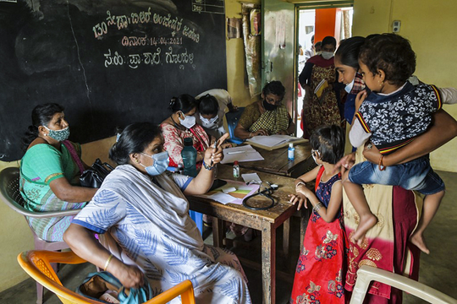


Case Study
Rural Healthcare: Telemedicine is a lifeline for remote communities with limited access to healthcare facilities, offering timely medical consultations and diagnoses to bridge the healthcare gap.
Mental Health: Teletherapy and counseling services provide a vital platform for individuals to access mental health support conveniently, ensuring they can receive help when and where they need it.
Specialist Consultations: With telemedicine, patients no longer need to endure the inconvenience and expenses of travel to consult specialists. This technology brings expert medical opinions to patients' screens, expanding healthcare options.

Slide 24


